Slide 1
Object-Oriented Analysis and Design -with UML 2, UP and design patterns
Design Patterns

Slide 2
Patterns and Frameworks
Pattern
Provides a common solution to a common problem in a context
Analysis/Design Pattern
Provides a solution to a narrowly scoped technical problem
Provides a fragment of a solution, or a piece of the puzzle
Framework
Defines the general approach to solving the problem
Provides a skeletal solution, whose details may be analysis/design patterns
Notes:
This slide was originally discussed in Architectural Analysis.
Frameworks enable scalability of development: the ability to develop and deliver systems as quickly as the market requires by using a leveraged solution.
An analogy in bridge-building may help clarify this. Examples of frameworks are suspension bridge, piling-and-trestle bridge, and cantilever bridge. Examples of design patterns are rivet fastener, bolt, and weld. In building a bridge, each is substitutable in some cases, and each is uniquely superior in other cases. (Both a weld and a bolt can be used to join two materials; the weld can be stronger if done correctly, but cannot be undone, repaired, or replaced as the bolt can.)
Taking the analogy a bit further, a suspension bridge can be a footbridge or the Golden Gate bridge. Both represent the same basic design approach and principles, so that one could readily say “that is a suspension bridge,” but the extensions and localizations cause the end result to be quite different.
A pattern codifies specific knowledge collected from experience. Patterns provide examples of how good modeling solves real problems, whether you come up with the patterns yourself or you reuse someone else’s. Design patterns are discussed in more detail on the next slide.
Frameworks differ from analysis and design patterns in their scale and scope. Frameworks describe a skeletal solution to a particular problem that may lack many of the details. These details can be filled in by applying various analysis and design patterns.
A framework is a micro-architecture that provides an incomplete template for applications within a specific domain. Architectural frameworks provide the context in which the components run. They provide the infrastructure (plumbing, if you will) that allows the components to co-exist and perform in predictable ways. These frameworks can provide communication mechanisms, distribution mechanisms, error processing capabilities, transaction support, and so forth.
Frameworks can range in scope from persistence frameworks that describe the workings of a fairly complex but fragmentary part of an application, to domain-specific frameworks that are intended to be customized (such as Peoplesoft, SanFransisco, Infinity, and SAP). SAP is a framework for manufacturing and finance.

Slide 3
What Is a Design Pattern?
A design pattern provides a scheme for refining the subsystems or components of a software system, or the relationships between them. It describes a commonly-recurring structure of communicating components that solves a general design problem within a particular context.
Erich Gamma et al. 1994. Design Patterns—Elements of Reusable Object-Oriented Software
Template Parameters
Pattern Name
Notes:
Design patterns are medium-to-small-scale patterns, smaller in scale than architectural patterns but typically independent of programming language. When a design pattern is bound, it forms a portion of a concrete design model (perhaps a portion of a design mechanism). Design patterns tend, because of their level, to be applicable across domains.

Slide 4
GRASP - patterns
GRASP stands for General Responsibility Assignment Software Patterns.
GRASP can be used when designing interaction (sequence) diagrams and class diagrams.
GRASP try to formalize "common sense" in object oriented design.
They do not usually contain "new" ideas. They try to codify existing knowledge and principles.

Slide 5
GRASP: When and Where?
GRASP Patterns provide guidance for assigning responsibilities to classes and, to a limited extent, determining the classes that will be in a design.
GRASP patterns can be applied to object oriented design.
Most GRASP patterns apply equally well to business process reengineering.
During analysis, when you are building a conceptual model of an organization that has more than one way to do something, GRASP patterns can provide guidance in selecting paths through the organization to include in the conceptual model.

Slide 6
The GRASP patterns are
Expert
Creator
High Cohesion
Low Coupling
Controller
Polymorphism
Pure Fabrication
Indirection
Don't talk to Strangers
http://en.wikipedia.org/wiki/GRASP_(object-oriented_design)

Slide 7
Gang of Four Design Patterns
Behavioral
Interpreter
Template Method
Chain of Responsibility
Command
Iterator
Mediator
Memento
Observer
State
Strategy
Visitor
Creational
Factory Method
Abstract Factory
Builder
Prototype
Singleton
Structural
Adapter
Bridge
Composite
Decorator
Facade
Flyweight
Proxy

Slide 8
Examples of Pattern Usage
Pattern | Example
Command (behavioral pattern) | Issue a request to an object without knowing anything about the operation requested or the receiver of the request: for example, the response to a menu item, an undo request, the processing of a time-out
Abstract factory (creational pattern) | Create GUI objects (buttons, scrollbars, windows, etc.) independent of the underlying OS: the application can be easily ported to different environments
Proxy (structural pattern) | Handle distributed objects in a way that is transparent to the client objects (remote proxy) Load a large graphical object or any entity object “costly” to create/initialize only when needed (on demand) and in a transparent way (virtual proxy)
Observer (behavioral pattern) | When the state of an object changes, the dependent objects are notified. The changed object is independent of the observers. Note: The MVC architectural pattern is an extension of the Observer design pattern
Notes:
In the Architectural Analysis module, we brought up architectural patterns when we had to define the architectural layout. (We chose the Layers pattern.) Now, we are beginning to narrow things down with design mechanisms. Design mechanisms are frequently made up of one or more design patterns.

Slide 9
Detailing the Command Pattern
Application
+menu
1
1
MenuItem
1
0..*
1
Command
Menu
0..*
- label : String
+items
+cmd
+ Process()
+ Clicked()
cmd.Process();
Notes:
The problem — imagine we want to build a reusable GUI component. To keep it simple, we will limit ourselves to the implementation of generic menus in a windowing system (in such a way that it will be possible to add new menus without having to modify the GUI component).
Application: it is the client class, it “simulates” the application.
Menu: to simplify, we will make the assumption that our “application” has only one menu represented by an association with a multiplicity of 1 and a role name menu.
MenuItem: a menu is composed of menu items.
Command: this is an abstract class. It has one operation called Process. It is an abstract operation, which means it must be overridden by subclasses of Command.
We will now make the assumption that the underlying windowing system requires that we define in MenuItem an operation called Clicked that will be automatically invoked when the user selects the corresponding menu during execution time. The code for Clicked is (using a Java-like pseudo-code):
cmd.Process();
See the Appendix for more information on Command Patterns.

Slide 10
Detailing the Command Pattern (continued)
Application
AskUser();
OpenCommand
DoOpen();
+ Process()
+cmd
+menu
1
1
MenuItem
1
0..*
1
Command
Menu
0..*
- label : String
+items
+ Process()
+ Clicked()
cmd.Process();
Notes:
Suppose now that you want to implement the menu command Open… Create a new class called OpenCommand that inherits from Command. This class overrides the operation Process to prompt the user to for the file to open and to open it:
AskUser();
DoOpen();

Slide 11
Detailing the Command Pattern (continued)
1. OpenCommand( )
Initialization
myapp
ocmd :
OpenCommand
2. AddItem("Open...",ocmd)
3. MenuItem("Open...", ocmd)
menu
aNewItem :
MenuItem
3. AskUser( )
4. DoOpen( )
The user selects the Open… menu item
1. Clicked( )
2. Process( )
theMenuItem
cmd :
Command
A user
Notes:
Look at the dynamic behavior of the system: first, create an interaction diagram showing the initialization of the system. When the system started up, the objects myapp:Application and menu:Menu were created. Then myapp creates the object ocmd:OpenCommand (message 1). Then it invokes a new operation from menu called AddItem that takes two arguments: s of type String (the label of the menu item to create) and c of type Command. Note that myapp passes to AddItem, a subclass of Command (message 2).
Menu creates a new menu item (message 3). The arguments of the constructor for MenuItem are the same as AddItem. The code of the constructor is straightforward:
label = s;
cmd = c;
It is very important to note that cmd is initialized with a subclass of Command but that MenuItem “thinks” it is a Command object! This is all the magic of polymorphism!
Now, draw a second interaction diagram that will show what happens when the user selects the menu item “Open…”. The Clicked operation is invoked (message 1). Clicked simply executes the Process operation of the associated cmd object. In this case, the cmd object is actually the OpenCommand object (although this is transparent to the MenuItem object).

Slide 12
Detailing the Command Pattern (continued)
OpenCommand
Application
+ Process()
+ OpenCommand()
AskUser();
- AskUser()
DoOpen();
- DoOpen()
+menu
1
1
MenuItem
Menu
0..*
0..*
- label : String
+ AddItem(s : String, c : Command)
+items
+ Clicked()
+ MenuItem(s : String, c : Command)
Clicked():
MenuItem():
cmd.Process();
cmd = c;
label = s;
+cmd
1
Command
+ Process()
Notes:
To complete the class diagram, there should be a Uses relationship from Application to OpenCommand to account for the fact that the former creates the latter, and there should be another Uses relationship from Menu to Command as the AddItem operation takes one argument of type Command.

Slide 13
Detailing the Command Pattern (continued)
app
Application
CloseCommand
OpenCommand
gui
Menu
MenuItem
com
Command
Notes:
So what about reuse? Assign the classes to packages: OpenCommand and Application to app (you have also added a new class, CloseCommand), Menu and MenuItem to gui and Command to com, now add the appropriate dependencies. You have created a reusable set of components (gui and com) independent of the application packages using them! MenuItem can be made an Implementation class only! Only Menu is exported.

Slide 14
Representing Design Patterns in UML
A design pattern is a parameterized collaboration:
The parameters (stereotype <<role>>) of the collaboration
Client Invoker ConcreteCommand
<<role>>
Client
Command
<<role>>
ConcreteCommand
+ Process()
<<role>>
Invoker
Command
+ Process()
Notes:
In the example on the previous slides, the Client role was played by the classes Application and Menu, the Invoker was MenuItem, and the ConcreteCommand was OpenCommand.

Slide 15
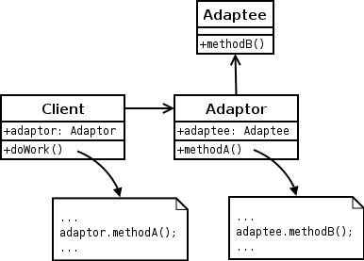
Adapter: Structural Pattern
Problem: How do we provide a single, stable interface to similar components with different interfaces?
How do we resolve incompatible interfaces?
Solution: Use an intermediate adapter object to convert calls to the appropriate interface for each component

Slide 16
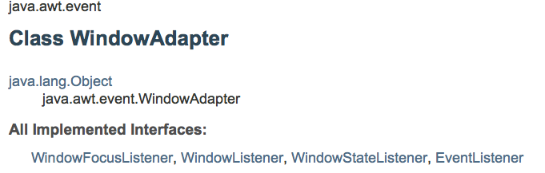
Adapter Example

Slide 17
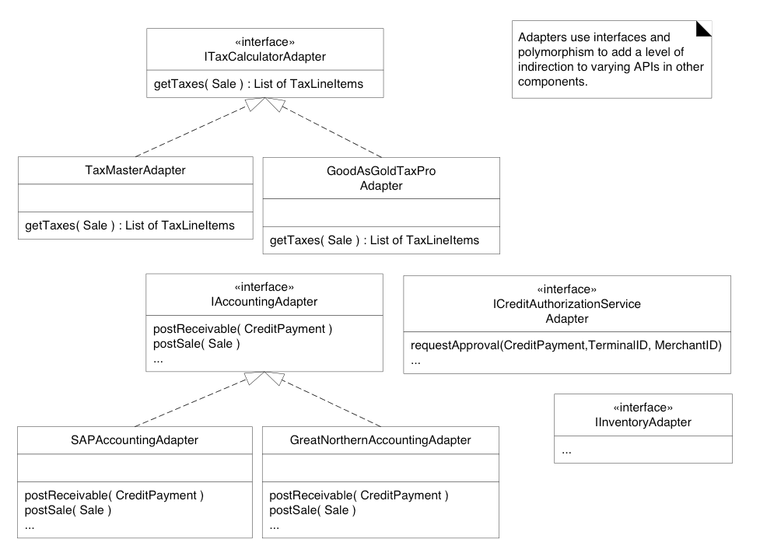
Adapter Examples

Slide 18
Adapter Example

Slide 19
GoF Adapter mapped to GRASP

Slide 20
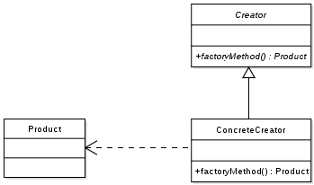
Factory: Creational Pattern
Problem: Who should be responsible for creating objects when there are special considerations like:
Complex creation logic
Separating creation to improve cohesion
A need for caching
Solution: Create a “Pure Fabrication” called a “Factory” to handle the creation
Also known as Simple Factory or Concrete Factory
Notes:
Simplification of Abstract Factory

Slide 21
Factory Exmaple

Slide 22
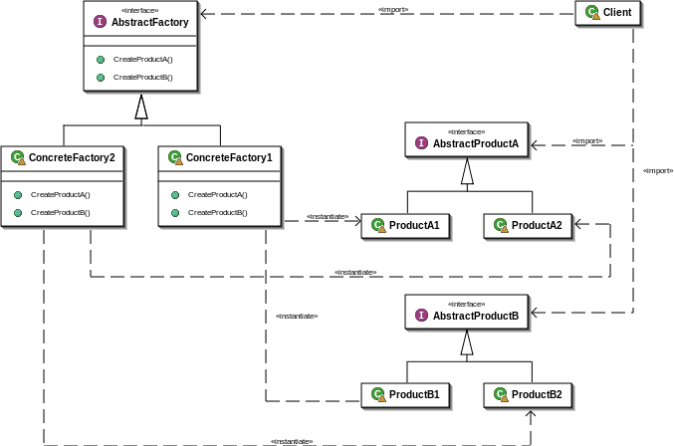
Abstract Factory: Creational Pattern
Provides an interface to create and return one of several families of related objects without needing to specify their concrete classes.

Slide 23
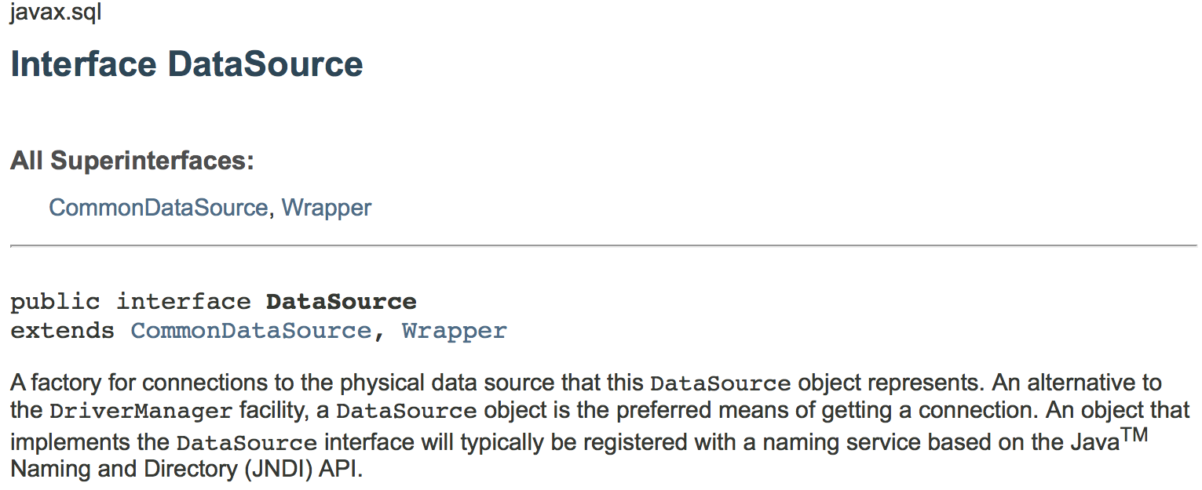
Factory Exmaple

Slide 24
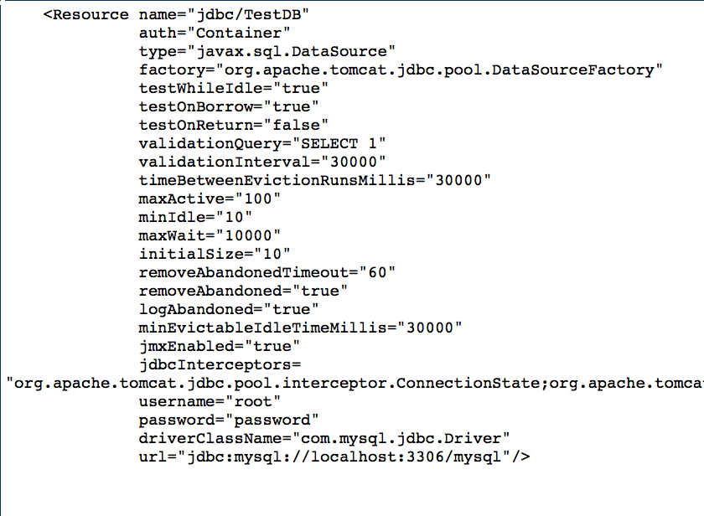
Tomcat JDBC Connection Pool

Slide 25

Singleton: Creational Pattern
Problem: How do we ensure that exactly one instance of a class is created and is globally accessible?
Solution: Define a static method in the class that returns the singleton instance
Created only once for the life of the program
Provides single global point of access to instance
Similar to a static or global variable variable
Notes:
Problem: Exactly one instance of a class is needed/allowed
Other objects need single, global point of access to it
Solution: Define a static method of a class that returns the Singleton
The static method can only create one instance
Issues
Who should create the Factory? The Singleton!
Provides global visibility via static method
Avoids passing factory reference to many clients

Slide 26
Singleton Example

Slide 27
Singleton Example

Slide 28
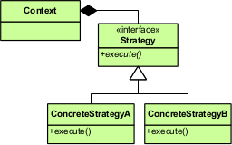
Strategy: Behavior Pattern
Problem: How do we design for varying, but related, algorithms or policies? How do we design for the ability to change these?
Solution: Define each algorithm or policy in a separate class with a common interface.
Notes:
Define a family of algorithms that are interchangeable and vary independently from the client that uses them

Slide 29
Strategy Example

Slide 30
Strategy Example

Slide 31
Using Factory to create strategy

